Slide 1
Communicative English Faculty – Dr. Kiran Magavi Department – Humanities and Social Sciences
Non Verbal Communication
Notes:
‹#›

Slide 2
Nonverbal Communication
Is it possible to communicate without words?

Slide 3
Nonverbal Communication
Studies show that over half of your message is carried through nonverbal elements:
Your appearance
Your body language
The tone and
the pace of your voice.

Slide 4
Nonverbal Communication
Before someone processes our verbal messages,
Taken in our appearance,
Registered our enthusiasm and sincerety
Noted our tone of voice and processed all into nonverbal message.
If this message reinforce the content of verbal one, it means we send a powerful message.
If the two messages do not match, they may cancel each other and that means nomessages delivered.

Slide 5
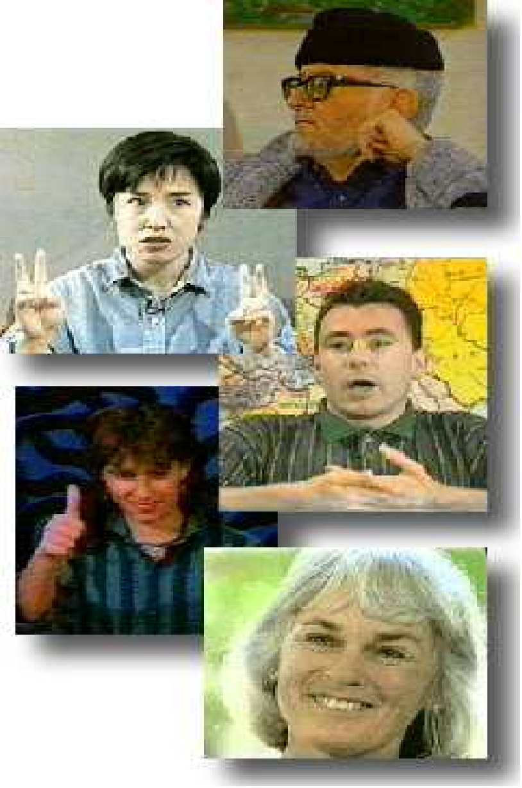
Nonverbal Communication
The process of sending and receiving wordless messages by means of facial expressions, gaze, gestures, postures, and tones of voice.
Nonverbal cues include all expressive signs, signals and cues ---which are used to send and receive messages
Notes:
‹#›

Slide 6
Language is not the only source of communication, there are other means also. Messages can be communicated through.
1. Gestures: It includes movement of hands, face or other parts of the body.
2. Posture or Body language
3. Facial expressions
4. Eye contact
5. Emblems
6. Haptics
7. Appearance & object

Slide 7
vocal characterizers
Laughing
Sighing
Crying
Belching
Inhaling
Excessive groaning
Whining
Yelling
Whispering

Slide 8
Note:
some sounds are not vocal,
e.g., snapping one’s fingers, stamping a foot
…nv includes vocal and non vocal phenomena

Slide 9
Some nonvocal
made with the breath,
taking a small bit of air
onomatopoetic words - zzz

Slide 10
Body Motion (Kinetic Gestures)
Movements of the:
Body
Limbs
Head
feet and legs
facial expressions
eye behavior
posture

Slide 11
Emblems
Thumbs up OK
V with fingers victory
Finger pointed to temple suicide
Hand grasping throat choke
hand to mouth eating
tilt head, eyes closed sleeping

Slide 12
Part of body associated with emblems
Often the hands... but not exclusively
Nose wrinkle Disgust
Drop of the jaw and exaggerated raising of the eyebrows Surprise
Upturned palms, shrugged shoulders Uncertainty

Slide 13
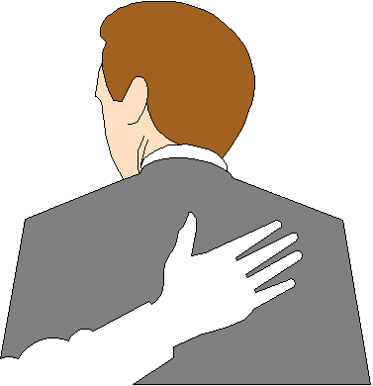
Touch Behavior
touching
stroking pushing
guiding another’s motion

Slide 14
We Express Ourselves Through….
Posture( Gait, Walk, sitting)
(Position of body)
Gestures( Movements of hands , Legs, fingers etc.)
(A Motion of hand, head or body to emphazize an idea or emotion while speaking)
Facial Expressions(Eyes, eyebrows, lips,chin)
Notes:
‹#›

Slide 15
The Silent Language
Our actions
silence
expressions in the eyes
gestures
posture
walk
Facial expression
Vocal cues
Touch
Appearance
-all these can communicate without words.

Slide 16
Emotions- Express with Facial Expressions
Surprise
Fear
Disgust
Anger
Happiness
Sadness
Notes:
‹#›

Slide 17
Physical Characteristics
Not all nonverbal communication comes through movement and motion
Some are static self presentation characteristics
body height
weight
hair
skin color
breath odor

Slide 18
First Impression
We know the importance of “first impression”
But first impressions happen everytime when we initiate the communication.
Positive first impression make communications much easier and more comfortable.
Negative first impressions can cut off a relationship before it gets started.

Slide 19
First Impression
First impression includes:
Dress & grooming
Voice
Handshake
Eye contact
Body posture

Slide 20
Language of Gestures
Body language and nonverbal communication are transmitted through the eyes, face, hands, arms, legs and posture (sitting and walking)

Slide 21
Words & Phrases That Usually Annoy and Hurt People
You should have known better…..
I can see no point in ..
You must realize that..
I find it difficult to believe….
Don’t be stupid..
You can’t do that…
That’s irrelevant...
Avoid absolutes unless you mean them.
Avoid putting the other person down.
Avoid superior sounding judgements.

Slide 22
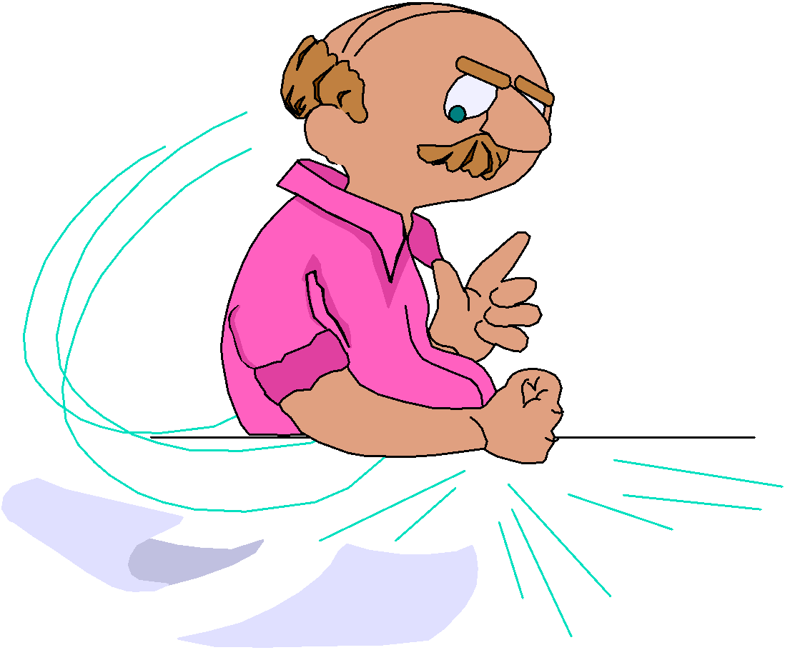
Saying What We Really Mean
The price we pay for not saying what we mean - or saying something we didn’t mean can cause guilt, anger, loss of self esteem.
Accusation, screaming, and aggressiveness can’t prove our point.

